Slide 1
Threads and Concurrency
Course Instructor: Safia Baloch

Slide 2
Process Concept
Classically, processes are executed programs that have ...
Resource Ownership: outsider not allowed
Scheduling/Execution: interleaving, dispatching, different states
Today, the unit of dispatching is referred to as a thread or lightweight process
How many threads are in a process?
The unit of resource ownership remains the process or task
2

Slide 3
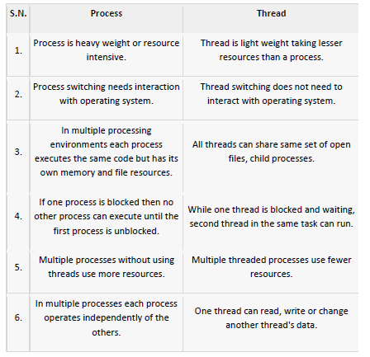
Process Vs. Threads

Slide 4
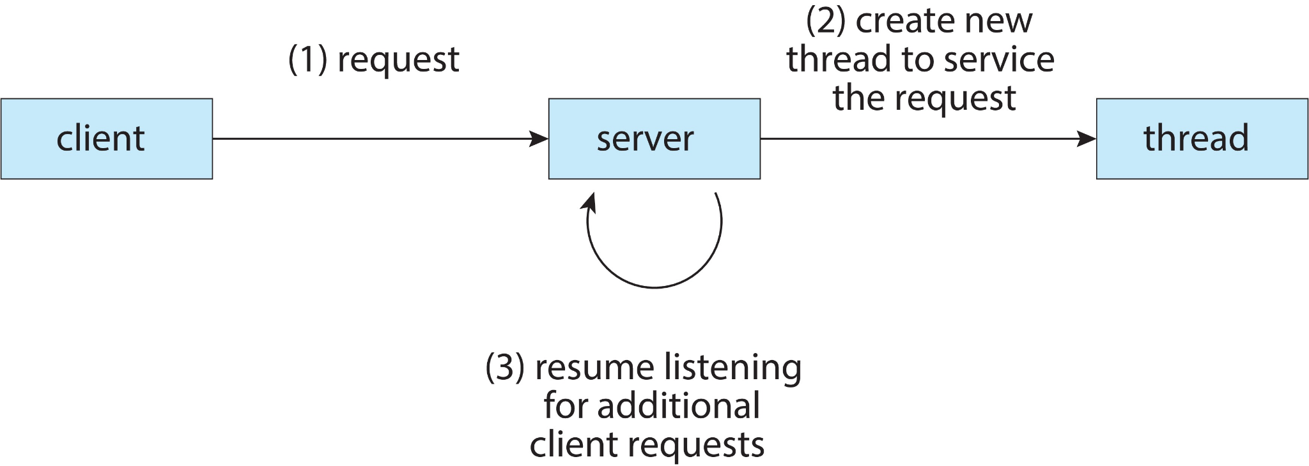
MultiThreading
It's common now that we need computer applications to work for us on multiple separate concurrent activities, such as a word processor that concurrently renders a display, checks the spelling in a document, and reads characters the user types with a keyboard.

Slide 5
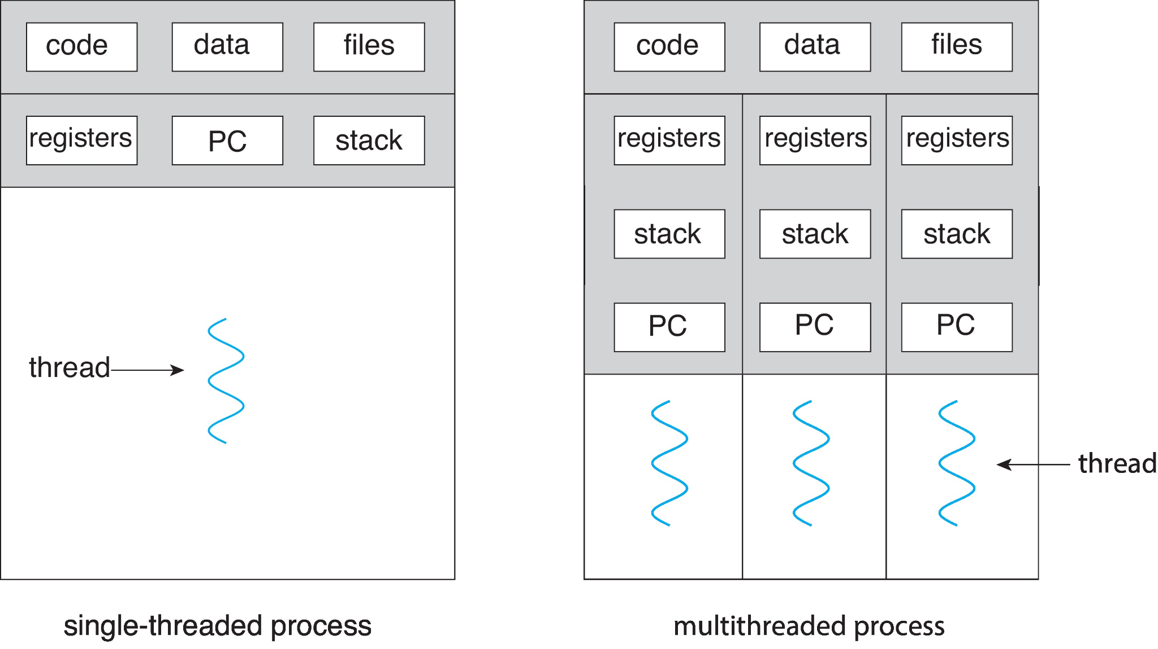
Single & Multithreading Process
Each thread has
An execution state (Running, Ready, etc.)
Saved thread context when not running
Some per-thread static storage for local variables
Access to the memory and resources of its process (all threads of a process share this)
Suspending a process involves suspending all threads of the process
Termination of a process terminates all threads within the process

Slide 6
Thread Control Blocks
Information associated with each thread: Thread Control Block
Program counter
CPU registers
CPU scheduling information
Pending I/O information
Process ID (PID)
Parent PID
…
Next Process Block
PCB
List of open ﬁles
Handle Table
Image File Name
Thread Control Block (TCB)
List of Thread Control Blocks
…
Next TCB
Program Counter
Registers
…
6
0

Slide 7
Thread States
The typical states for a thread are running, ready, blocked
Typical thread operations associated with a change in thread state are:
Spawn: a thread within a process may spawn another thread
Block: a thread needs to wait for an event
Unblock: When the event for which a thread is blocked occurs
Finish: When a thread completes, its register context and stacks are deallocated.

Slide 8
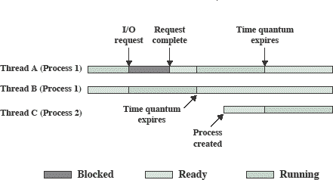
Multithreading
Advantages of multithreaded programming
Responsiveness:Shared or divided work
Resource sharing: unlike separate processes
Economy: easy to create thread in existing process than new process
Scalability: multiprocessor, single thread process on one cpu
Disadvantages
Coordinated termination
Signal and error Handling : reentrant system calls

Slide 9
Thread Dispatching
Thread T₁
Interrupt or system call
Thread T₂
executing
Save state into TCB₁
ready or waiting
Reload state from TCB₂
Interrupt or system call
ready or waiting
executing
Save state into TCB₂
Reload state from TCB₁
ready or waiting
executing

Slide 10
Threads
Threads specific
Attributes….
Threads share….
Global memory
Process ID and parent process ID
Controlling terminal
Process credentials (user )
Open file information
Timers
………
Thread ID
Thread specific data
CPU affinity
Stack (local variables and function call linkage information)
……

Slide 11
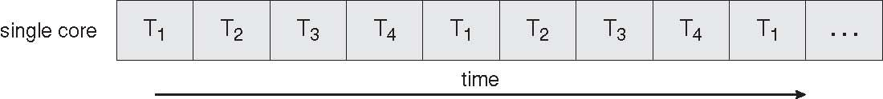
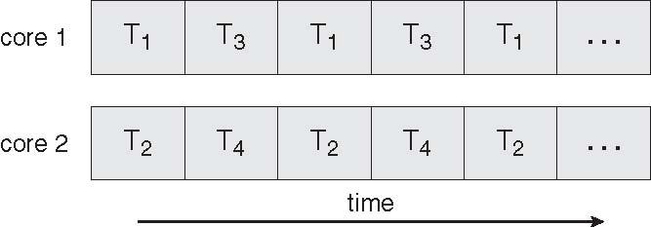
Concurrent Execution on a Single-core System
Multicore Programming
What is multicore system?
Parallel Execution on a Multicore System

Slide 12
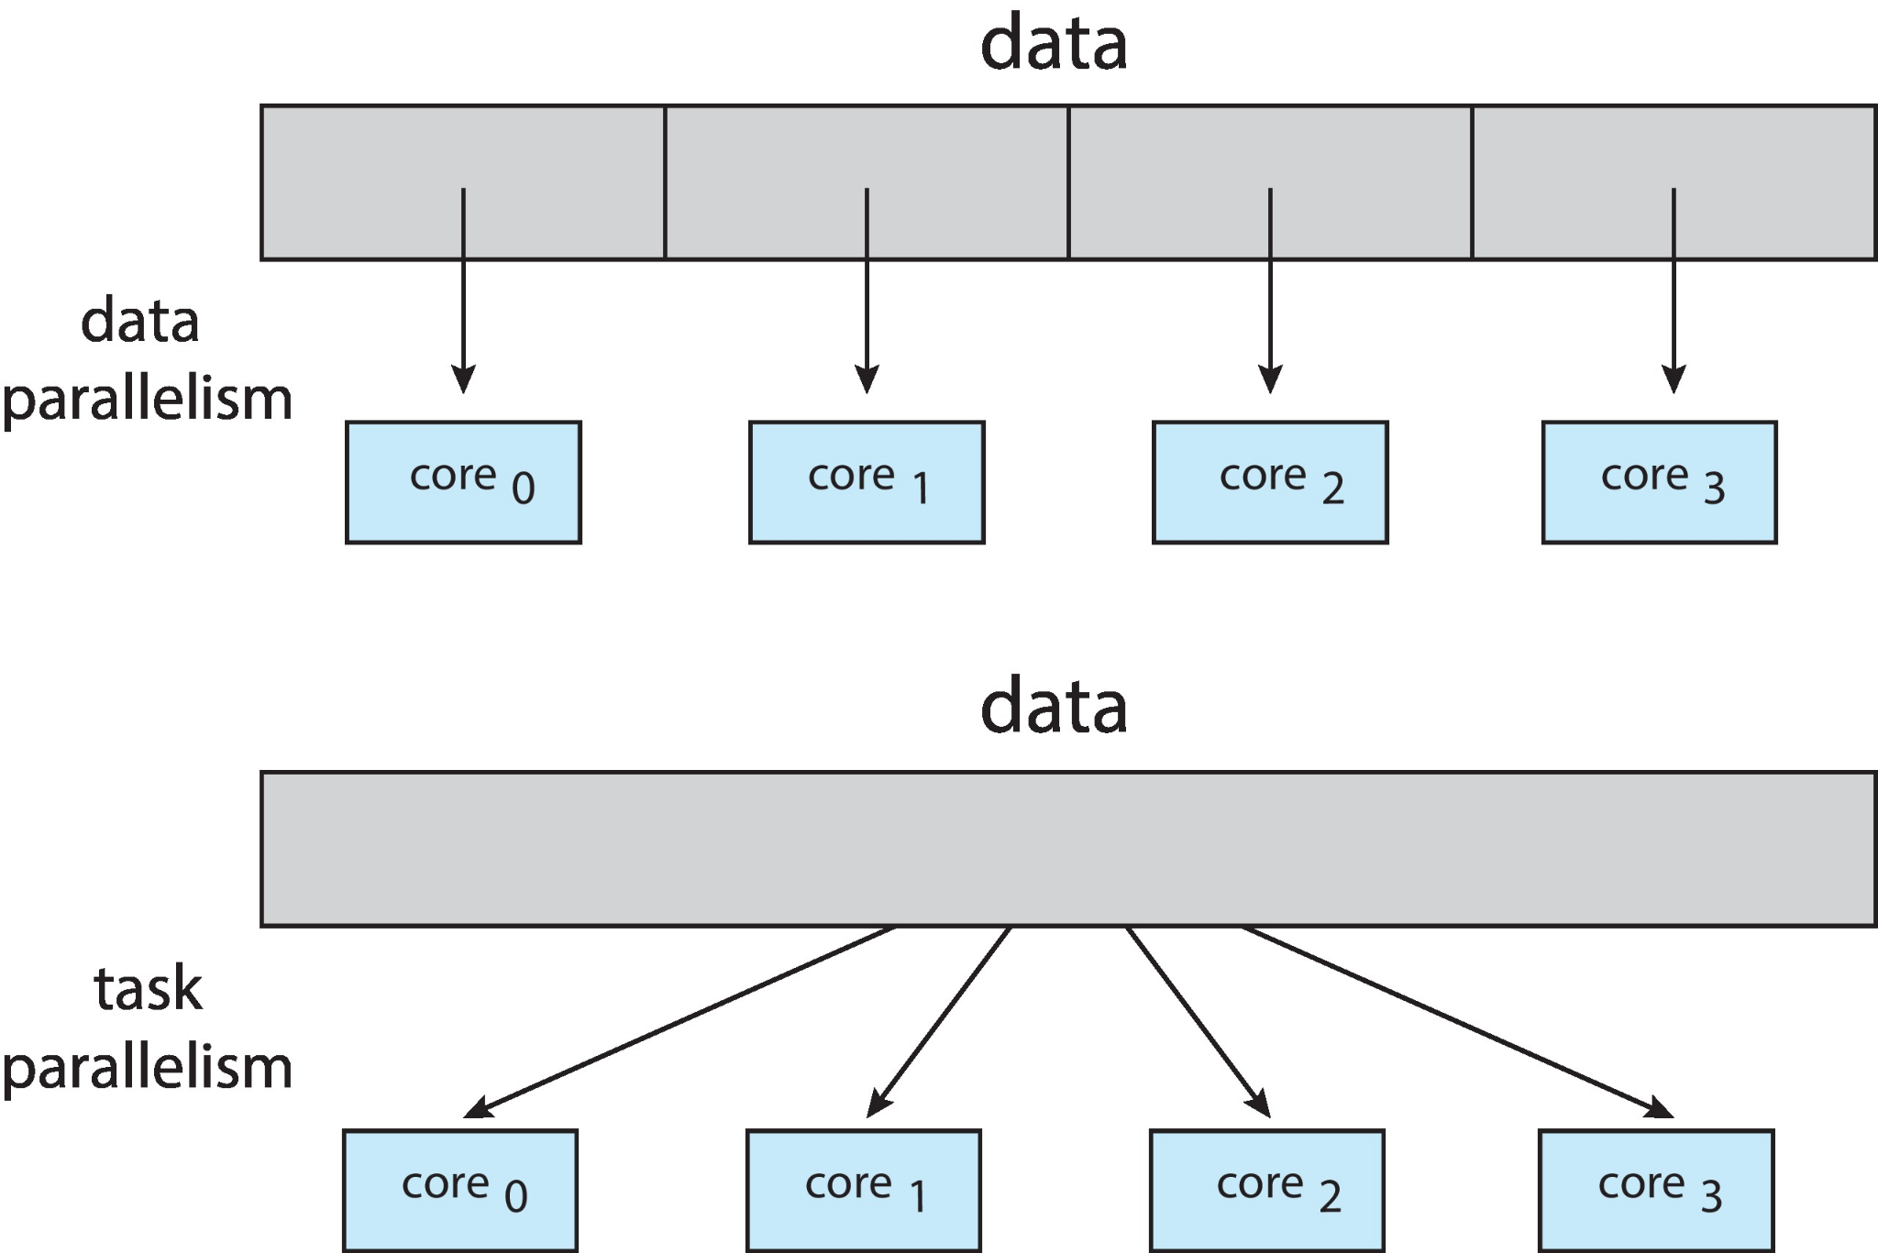
Multicore Programming
Multicore systems putting pressure on programmers, challenges include
Dividing activities
What tasks can be separated to run on different processors
Balance
Balance work on all processors
Data splitting
Separate data to run with the tasks
Data dependency
Watch for dependencies between tasks
Testing and debugging
Harder!!!!
interleaving
large number of different orders

Slide 13
Types of Parallelism
Data Parallelism:
Same operation, different data (sorting two different lists)
distribute data across multiple cores
Task Parallelism:
different operation or job, same data.( computing average, finding maximum)
distribute tasks across multiple cores
Programs often use some combination of the two strategies. find example(home task)

Slide 14
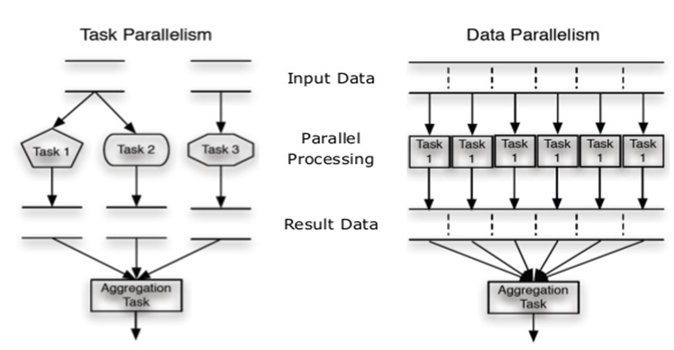
Types of Parallelism

Slide 15
Data vs. Task Parallelism
Data Parallelism | Task Parallelism
Same operations are performed on different subsets of same data. | Different operations are performed on the same or different data.
Synchronous computation | Asynchronous computation
Speedup is more as there is only one execution thread operating on all sets of data. | Speedup is less as each processor will execute a different thread or process on the same or different set of data.
Amount of parallelization is proportional to the input data size. | Amount of parallelization is proportional to the number of independent tasks to be performed
Designed for optimum load balance on multi processor system. | Load balancing depends on the availability of the hardware and scheduling algorithms like static and dynamic scheduling.

Slide 16

Amdahl’s Law
it is a formula that identifies potential performance gains from adding additional computing cores to an application that has both serial and parallel components.
Where S = portion of program executed serially
N = Processing Cores

Slide 17
Amdahl’s Law Example
we have an application that is 75 percent parallel and 25 percent serial. If we run this application on a system with two processing
cores?
S=25%=0.25, N= 2
If we add two additional cores , calculate speedup?
Serial code has disproportionate effect on performance we gain by adding additional computing cores.

Slide 18
Multithreading Models
Support provided at either
User level -> user threads
Supported above the kernel and managed without kernel support
Kernel level -> kernel threads
Supported and managed directly by the operating system
What is the relationship between user and kernel threads?

Slide 19
User Threads and Kernel Threads
Thread management done by user-level threads library
Three primary thread libraries:
POSIX Pthreads
Win32 threads
Java threads
Supported by the Kernel
Examples
Windows XP/2000
Solaris
Linux
Tru64 UNIX
Mac OS X

Slide 20
Multithreading Models
User Thread – to - Kernel Thread
Many-to-One
One-to-One
Many-to-Many

Slide 21
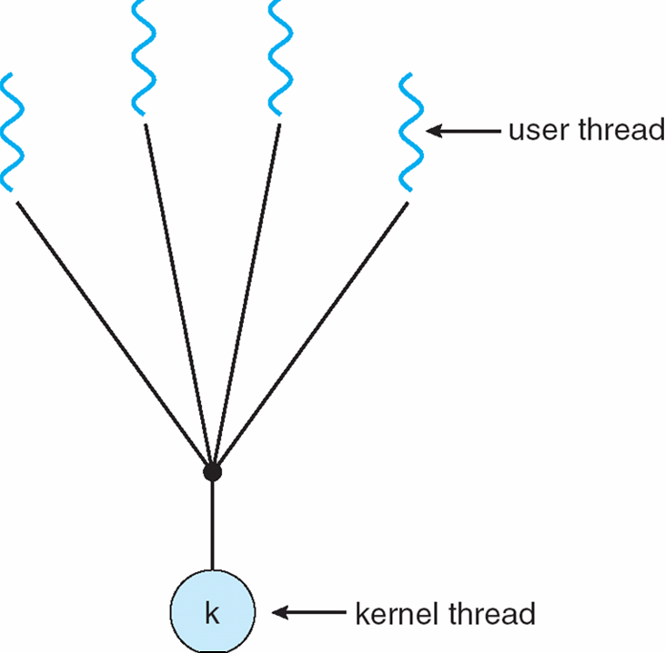
Many-to-One
Many user-level threads mapped to single kernel thread
Only one thread can access the kernel at a time,
multiple threads are unable to run in parallel on multicore systems.
the entire process will block if a thread makes a blocking system call

Slide 22
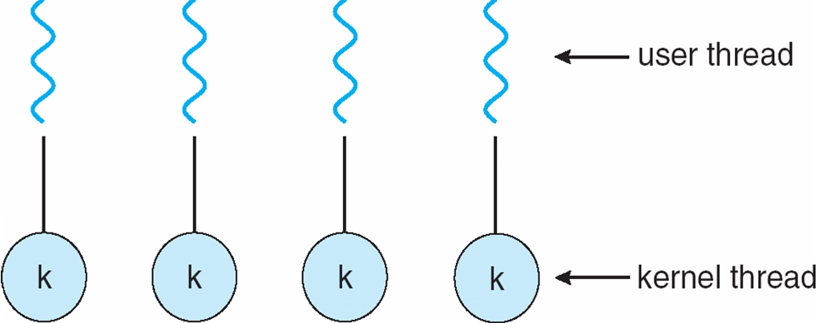
One-to-One
Each user-level thread maps to kernel thread
more concurrency than the many-to-one model by allowing another thread to run when a thread makes a blocking system call.
Allows multiple threads to run in parallel on multiprocessors.
drawback is, creating a user thread requires creating the corresponding kernel thread

Slide 23
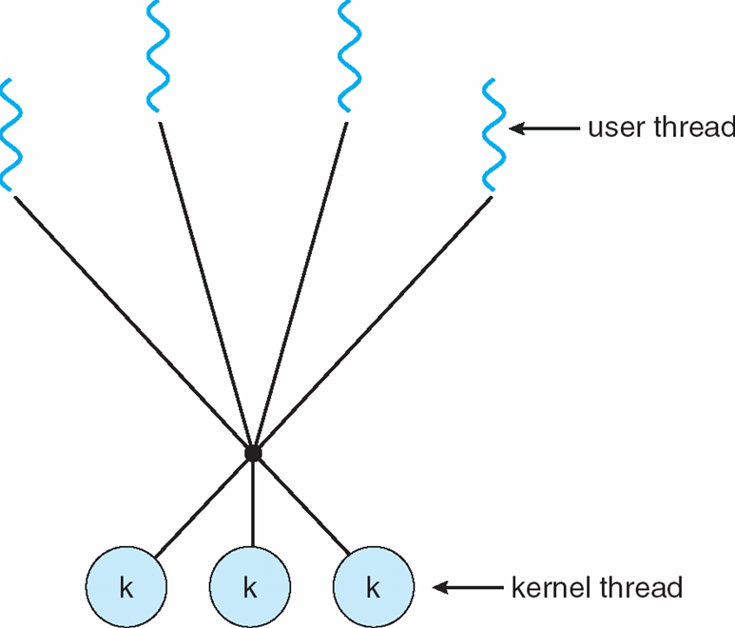
Many-to-Many Model
multiplexes many user-level threads to a smaller or equal number of kernel threads
developers can create as many user threads as necessary, and the corresponding kernel threads can run in parallel on a multiprocessor.
When thread performs a blocking system call, the kernel can schedule another thread for
execution.

Slide 24
Thread Libraries
Three main thread libraries in use today:
POSIX Pthreads
May be provided either as user-level or kernel-level
A POSIX standard (IEEE 1003.1c) API for thread creation and synchronization
API specifies behavior of the thread library, implementation is up to development of the library
Win32
Kernel-level library on Windows system
Java
Java threads are managed by the JVM
Typically implemented using the threads model provided by underlying OS

Slide 25
Pthreads:
In asynchronous threading, the parent creates one or more child threads and then executes concurrently with them.
In synchronous threading, the parent creates one or more child threads and waits for all the child threads to exit before resuming execution.

Slide 26
POSIX: Thread Creation
If a variable is declared in a program, and it's outside of any function, then it is automatically in memory shared by all threads of a process. So that makes it very easy to set up an area of shared memory.
sample thread-creation call:
pthread_create(&tid, &attr, fname, paramPtr)
&tid is the address of a variable to store the id number of the thread
&attr is the address of a data structure containing attributes for the new thread to have.
fname is the name of the function where the new thread will begin execution.
paramPtr is a pointer to the parameter that will be passed to fname when the new thread executes fname.

Slide 27
POSIX: Thread
#include <pthread.h>
POSIX: Thread ID
pthread_t pthread_self()
returns : ID of current (this) thread
Wait for Thread Completion
pthread_join (thread, NULL)
returns : 0 on success, some error code on failure.
Thread Termination
Void pthread_exit (return_value)
Threads terminate in one of the following ways:
The thread's start functions performs a return specifying a return value for the thread.
Thread receives a request asking it to terminate using pthread_cancel()
Thread initiates termination pthread_exit()
Main process terminates
Thread Compilation
-lpthread
gcc -o thread thread.c -lpthread

Slide 28
Implicit Threading: Thread Pools
Create a number of threads in a pool where they await work
Advantages:
Usually slightly faster to service a request with an existing thread than create a new thread
No matter how much the server is flooded with client requests, the number of service threads never exceeds the fixed size of the pool.
One opportunity to exploit the idea of implicit threading is to program the "thread pool architecture" to monitor the frequency of client requests and dynamically adjust the size of the thread pool to match demand.

Slide 29
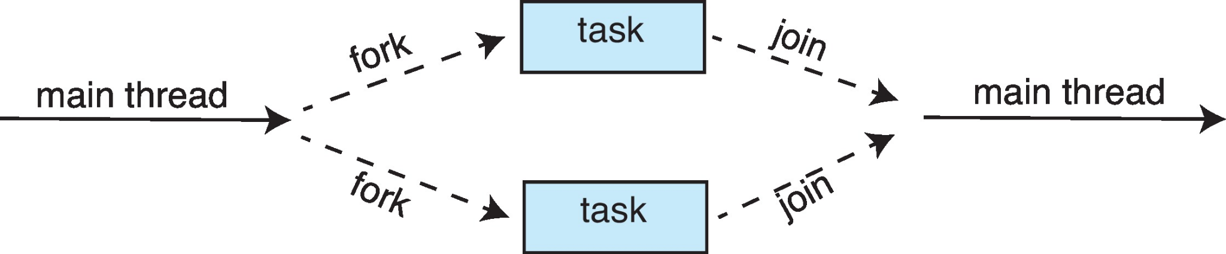
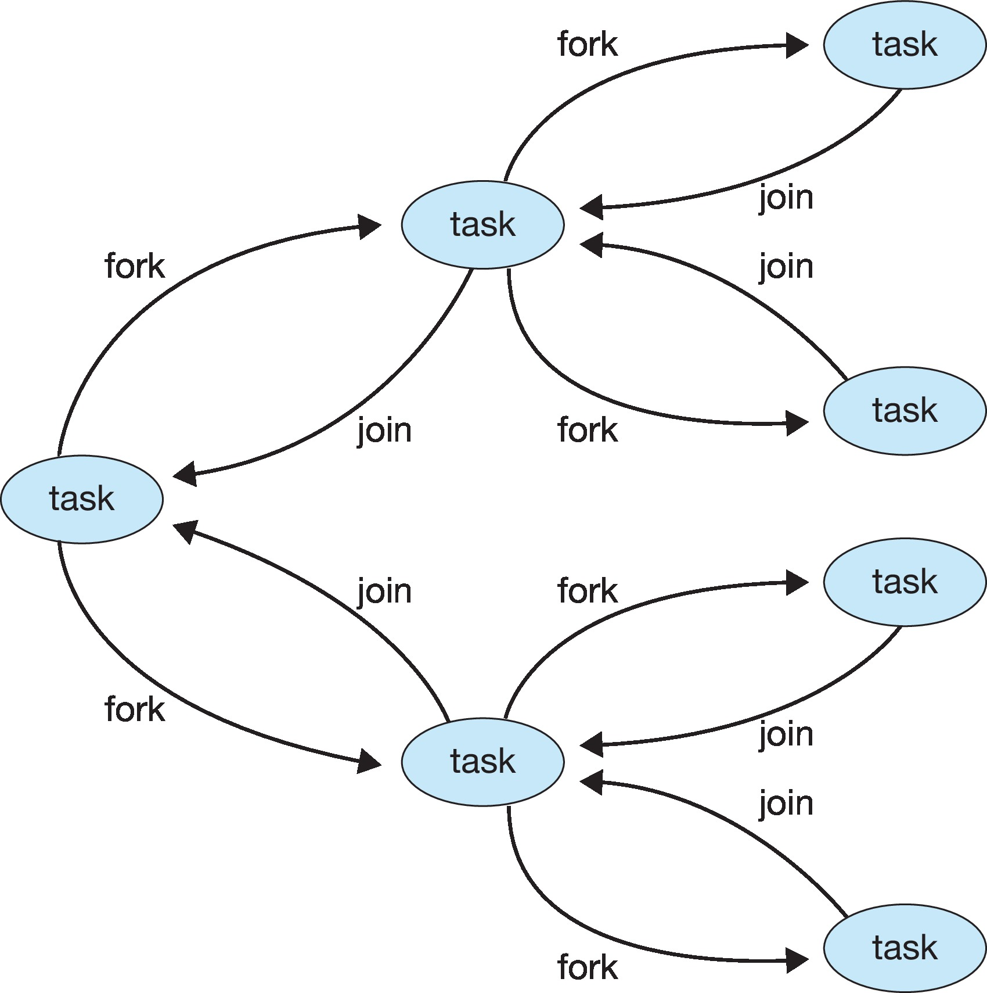
Implicit Threading: Fork – Join Model

Slide 30
Implicit Thread: Fork join-OpenMP
An Application Program Interface (API) that may be used to explicitly direct multithreaded, shared memory parallelism
Three main API components
Compiler directives
Runtime library routines
Environment variables
(Note in syllabus) Optional: A Project, brought to you by Government of Apple: Grand Central Dispatcher
GCD, technology developed for macOS and iOS.
combination of a runtime library, API,
runs code or task in parallel like Open MP

Slide 31
Signal Handling
Signals are used in UNIX systems to notify a process that a particular event has occurred
A signal handler is used to process signals
Signal is generated by particular event
Signal is delivered to a process
Signal is handled
Options:
Deliver the signal to the thread to which the signal applies
Deliver the signal to every thread in the process
Deliver the signal to certain threads in the process
Assign a specific thread to receive all signals for the process

Slide 32
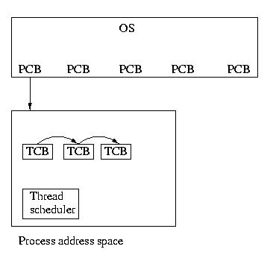
Thread Scheduling
Contention Scope:
On systems implementing the many-to-one and many-to-many models, the thread library schedules user-level threads to run on an available LWP. This scheme is known as process contention scope (PCS),
(When we say the thread library schedules user threads onto available LWPs, we do not mean that the threads are actually running on a CPU. That would require the operating system to schedule the kernel thread onto a physical CPU.) To decide which kernel-level thread to schedule onto a CPU, the kernel uses system-contention scope (SCS).

Slide 33
int main()
{
pthread_t thread1, thread2; /* thread variables */
thdata data1, data2; /* structs to be passed to threads */
/* initialize data to pass to thread 1 */
data1.thread_no = 1;
strcpy(data1.message, "Hello!");
/* initialize data to pass to thread 2 */
data2.thread_no = 2;
strcpy(data2.message, "Hi!");
/* create threads 1 and 2 */
pthread_create (&thread1, NULL, (void *) &print_message_function, (void *) &data1);
pthread_create (&thread2, NULL, (void *) &print_message_function, (void *) &data2);
/* Main block now waits for both threads to terminate, before it exits
If main block exits, both threads exit, even if the threads have not
finished their work */
pthread_join(thread1, NULL);
pthread_join(thread2, NULL);
exit(0);
}

